Slide 1

Supply Chain Consortium Initiative
Ms. Danielle Knox
429 SCMS/GUMD
Christina.knox@us.af.mil
&
Ms. Raegan Richardson
429 SCMS/GUMD
Raegan.richardson@us.af.mil

Slide 2
Purpose of Other Transactions
The DoD OT authorities were created to encourage new or nontraditional performers to work with the Department. These authorities allow DoD to bring new, cutting-edge solutions to the warfighter by accommodating a performer's existing business practices and commercial industry standards rather than imposing DoD standards
OTs can help:
Engage with nontraditional defense contractors who may not be interested in entering into Federal Acquisition Regulation (FAR)-based contracts
Broaden the industrial base available to the Government
Support dual-use projects
Encourage quicker, cheaper, and more flexible project design and execution
Leverage commercial technology development
Ensure DoD requirements are incorporated into future commercial products
Collaborate in innovative arrangements

Slide 3
OTA History and Types
OTA History
1958: NASA granted first authority to use OTs
1989: DARPA granted OTs for Research
1994: DARPA granted OTs for Prototype Projects
1995 – 2014: Authority granted to 11 other Agencies
2016: OTs permanently codified in 10 USC 2371b
2017: Public Law 115-91 §864 expanded authority for Other Transactions for Prototype Projects (10 USC 2371b)
OTA Types
Other Transactions for Prototype Projects (10 USC 2371b)
Provide a direct benefit to the DoD
Considered Acquisition Instruments
Other Transactions for Research (10 USC 2371)
Provide stimulation or support of research
Technology Investment Agreements (TIAs)
Procurement for Experimental Purposes (10 USC 2373)
Experimentation and test purposes
FAR applies when purchases are made in quantity

Slide 4
OTA Prototype Project
What is a Prototype Project:
Definition: A prototype project addresses a proof of concept, model, reverse engineering to address obsolescence, pilot, novel application of commercial technologies for defense purposes, agile development activity, creation, design, development, demonstration of technical or operational utility, or combinations of the foregoing. A process, including a business process, may be the subject of a prototype project. (2018 DoD OTA Guide V1.0)
Scope: Must be “directly relevant to enhancing the mission effectiveness of military personnel and the supporting platforms, systems, components, or materials proposed to be acquired or developed by the Department of Defense, or to improvement of platforms, systems, components, or materials in use by the armed forces.” (10 USC 2371b(a)).
Leading to prototype, modify, enhance, test, measure, document, and integrate next generation, OSA for capabilities and tools that satisfy requirements for open-architecture systems

Slide 5
OTA Appropriate use of Authority
Per 10 US 2371b, an OTA may be used when at least one of the following apply:
At least one Nontraditional Defense Contractor or nonprofit research institute participating to a significant extent in the prototype or project, or
An entity that is not currently performing and has not performed, for at least the one-year period preceding the solicitation
All Significant Participants in the transaction other than the Federal Government are Small Businesses (including those participating in a program described under section 9 of the Small Business Act (15 USC 638) or Nontraditional Defense Contractors
Supplying New Key Technology or products
Accomplishing a Significant Amount of the effort
Causing a Material Reduction in the cost or schedule or increase in performance

Slide 6


Common OTA Models
Direct OTA
Direct Award
Custom Terms
Direct Payment
May Require and/or Consume More USG Resources to Administer/Manage
Possible increased lead times
Solicitation (i.e. BAA or program specific)
Consortium Model
Projects Awarded to Consortium Manager
Custom Terms & Flow-Downs
Payment to Consortium
Consortium Acts as Mentor
Publicizes Projects to Consortia
Administrative Fee
Notes:
BAA = Broad Area Announcement

Slide 7
OTA + Consortium Model
System of Systems (SOSSEC) Consortium is the SCCI Awardee
1000+ Member Companies
Broad spectrum of Defense Contractors, Nontraditional Defense Contractors, Academia, and Non-profit Organizations
Breadth of Capabilities, Expertise, and Technology
Low barrier-to-entry for new Consortium Members
SOSSEC, Inc. acts as the OT Lead Organization
Single Point of Contact for Contracting/Administration
Quality Control on Proposals/Reports/Invoicing
Provides price reasonableness analysis on proposals
Receives Administration Fee
Ensures Deliverables are Provided
Enables the Nontraditional Contractor to focus on Technical Performance not Business/Contracting Issues
Key Information
Contract PoP | 10 yr (1 Oct ‘19-30 Sep ‘29)
Accumulative Ceiling | $99M*
SOSSEC ‘s Admin Fee | 3.75%
Incentives paid to SOSSEC - Negotiated on each Individual Project Agreement | Up to 1%
*Funding due prior to solicitation by customer

Slide 8


Communication ROEs
Pre-Award
Members/
Contractors
Customers
Post-Award
Issues, Changes, MS approvals
GFP Request, Extension Requests, Issues
Members/
Contractors
Customers
Program Management
& Validation

Slide 9
Project Level Agreements
Prototype Projects are Awarded to SOSSEC
Firm Fixed Price Prototype Projects
Milestone payments track technical progress
OT is Amended to add the Project, Milestones, and Funding
Competitive procedure shall be used “to the maximum extent practicable.” (10 USC 2371b)
SOSSEC then enters into a Project Level Agreements with the Consortium Member (Project-Level Performer)
Not a Prime-Subcontractor Relationship
Project Level Performer is responsible for technical work however, SOSSEC responsible for delivery
Government has direct insight into the technical performance
SOSSEC acts a Mentor to the Performer and Intermediary for the Government

Slide 10
OTA Prototype Transition
Sole source follow-on production contract(s) or transaction(s) may be awarded when:
The acquisition approach for the prototype project addressed the strategy for follow-on activities and the following two criterion are satisfied:
Competitive procedures were used for the selection of parties for participation in the transaction; and
The participants in the transaction successfully completed the prototype project provided for in the transaction
Topic: DFARS Final Rule - Exception to Competition for Certain Follow-On Production Contracts
Reference: DFARS Case 2019-D031 — Effective February 28, 2022
Summary: DoD has issued a final rule amending the DFARS to implement a section of the NDAA for Fiscal Year 2016 that modifies the criteria required to exempt from competition certain follow-on production contracts.
The follow-on for the first run of production can be a FAR based contract or Other Transaction

Slide 11
SCCI Solicitation Methods
Two Solicitation Approaches:
Request for White Papers (RFWP)
Request for Prototype (RFPP)
SCCI works with the respective Program Offices to determine the best acquisition approach for each individual prototype project
Prototype projects are solicited competitively with all members of the SOSSEC consortium eligible for a project award
RFPP → Award = One-step Process
RFWP → RFPP → Award = Two-step Process*
*Highly Recommended
Goal of 150 Days
Define RQMTs
RFWP
RFPP
Competitive
Selection
Negotiations
Award
Competitive

Slide 12
Other Items
All GFP requests go through SCCI team
Be prepared to ship at award
All Invoices processed through SCCI team
PRPS not required
All schedule changes processed through SCCI team
During Pre-Award Phase all contractor communications are done through SOSSEC
All negotiations handled by SCCI team
Follow on sole source/first run of production competition meet per 10 USC 2371b*

Slide 13
SCCI Accomplishments
Awarded 33 projects for $27M
FY20 awarded 21 projects
18 for TAFB / 3 for HAFB
FY21 awarded 1 project
1 for RAFB
FY22 awarded 2 projects
2 for TAFB
FY23 awarded 4 projects
2 project award for TAFB / 1 Army project
FY24 awarded 5 projects (4 TAFB / 1 RAFB)
1 project in work for TAFB
Completed projects (21 projects)
20.21 Fuel Shut off valve w/PHT Aerospace Inc.– HAFB
20.15 TF33 w/Fairmount – TAFB
20.01 TF33 w/Parts Life, Inc. – TAFB
20.20 KC-135 Air Inlet Guide w/Renaissance Services Inc. – HAFB

Slide 14
Points of Contact
Supply Chain Consortium Initiative OTA workflow
448SCMW.SASPO.SCCI@us.af.mil
Supply Chain Consortium Program Managers
Danielle Knox, 429 SCMS/GUMD SASPO
Email: christina.knox@us.af.mil
Phone: (405) 818-3225
Raegan Richardson, 429 SCMS/GUMD SASPO
Email: raegan.richardson@us.af.mil
Phone: (405) 739-2258
Supply Chain Consortium Agreements Officer
Roxanne Yorgason, AFMC AFSC/PZAAC (TAFB)
Email: roxanne.yorgason@us.af.mil
Phone: (312) 739-9448

Slide 15

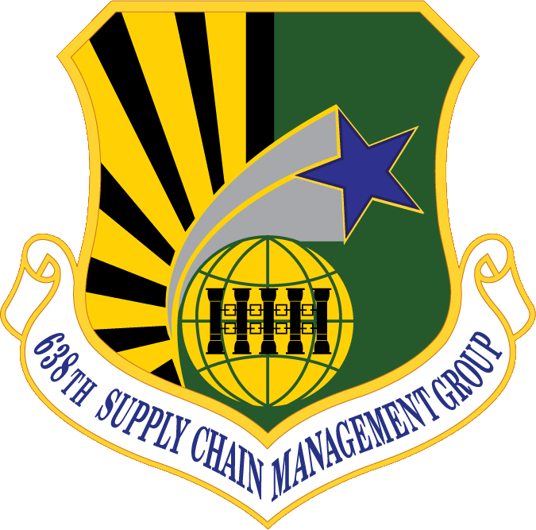

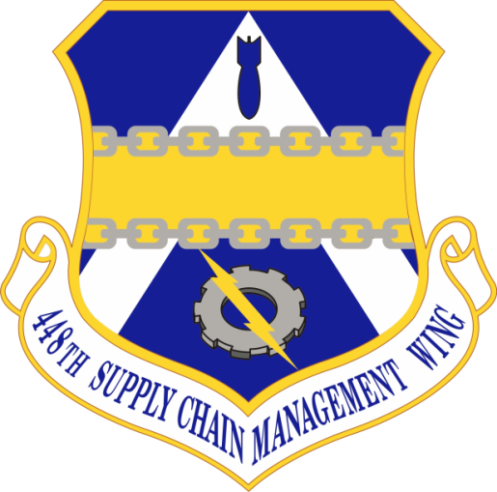
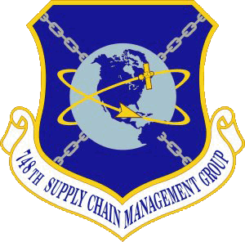
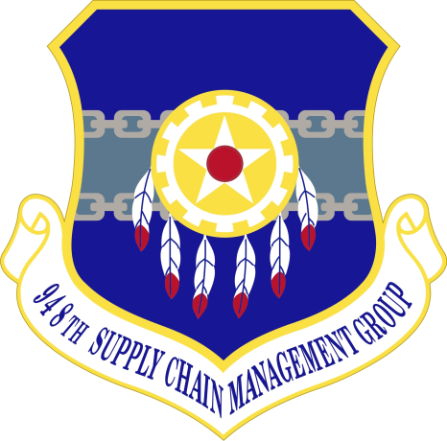
448th Supply Chain Management Wing
Supplying Warfighter Dominance

